Slide 1

Sinhgad College of Engineering, Pune – 41.
Department of Electronics & Telecommunication Engineering
“ Door Locking System Using Face Recognition ”
By :
Rishabh Mantri 72022536B
Mayur Vishwakarma 72022755M
Rohit Kalveni 72022545M
*
Guide :- Prof. A.B. Kale
Notes:
1
1

Slide 2
CONTENTS
1. Introduction
2. Problem Statement
3. Objective
4. Literature Survey
5. Block Diagram
6. Block Diagram Description
7. Specification of Hardware
8. Software Application Used
9. Why Raspberry Pi..?
10. Simulation
11. Flowchart
12. Implementation
13. Algorithm
14. Results
15. Applications
16. Advantages
17. Conclusion
18. References
*
Sinhgad College of Engineering, Pune – 41.
Department of Electronics &Telecommunication Engineering
2
Notes:
2
2

Slide 3
INTRODUCTION
We live in the 21st century where everything is preferred to be fast contactless and automated. COVID has even more increased the need for contactless systems. Well, here we propose a contactless doorbell as well as safety system using IOT for automatic visitor recognition and alerting homeowner.
The level of security can be raised by using face detection. The proposed face recognition door lock security system has been developed to prevent unauthorized access in highly secure areas like home environment with lesser power consumption and more reliable standalone security device for both Intruder detection and for door security.
Whenever the person comes in front of the door, it recognizes the face and if it is registered then it unlocks the door, if the face is not registered it will raise an alarm and clicks a picture and send it on the registered number. This is how the system works.
*
Sinhgad College of Engineering, Pune – 41.
Department of Electronics &Telecommunication Engineering
3
Notes:
3
3

Slide 4
PROBLEM STATEMENT
To design and implement a system with minimum human intervention for door locking system for security and safety.
The purpose of this system is to control the door lock using IOT website and Raspberry Pi.
*
Sinhgad College of Engineering, Pune – 41.
Department of Electronics &Telecommunication Engineering
4
Notes:
4
4

Slide 5
OBJECTIVE
To study a smart and secure door locking system which works by capturing the face of the visitor and checking it into its database.
To develop a system in which whenever a person rings the bell, image of the person is captured and would be send to the houseowner.
To analyze that if person’s image is present in database, then accordingly perform its functionality. And if image is not present in the database, then the smart lock system will send the image to IOT website to the owner.
*
Sinhgad College of Engineering, Pune – 41.
Department of Electronics &Telecommunication Engineering
5
Notes:
5
5

Slide 6
LITERATURE SURVEY
Sr. No. | Authors | Proposed Method | Advantages
1. | Dr. Syed Akhter Hossain | An intelligent system is proposed in this paper to secure our doors with face authentication. The human face is a unique and easy identifying feature of a human | The system can detect and recognizing human faces from a real-time video.
2. | Adarsh Patil, Sreevarsha Prakash, S. Akshay, Mahadevaswamy, Chandanb Patgar, J. SharathKumarA | Android based Smart Door Locking System | The cost-effective implementation with advanced functionality and easy to use interface makes the system very useful.
*
Sinhgad College of Engineering, Pune – 41.
Department of Electronics &Telecommunication Engineering
6
Notes:
6
6

Slide 7
LITERATURE SURVEY
Sr. No. | Authors | Proposed Method | Advantages
3. | Akash Deep Singh, Bir Singh Jangra, Ruchika Singh | Used a combination of webcam, Raspberry Pi, relay, solenoid door lock, and GSM module to create this system. To detect the face, we employed the Haar Cascade classifier approach, and to recognize the face, we used the Local Binary Pattern Histogram (LBPH) | This technology can be used to verify identity at home, in banks, and in other public locations
4. | Sharvani Yedulapuram, Rajeshwarrao Arabelli, Kommabatla Mahender, Chintoju Sidhardha | Computer vision is used within the IOT. For security purpose, we\'ve implemented real time face detection by Deep Learning algorithms | This system can be useful for senior citizens living alone and for immobilized people. Practically easy to construct and easy to track the path.
*
Sinhgad College of Engineering, Pune – 41.
Department of Electronics &Telecommunication Engineering
7
Notes:
7
7

Slide 8
LITERATURE SURVEY
Sr. No. | Authors | Proposed Method | Advantages
5. | Pradnya R. Nehete, J. P. Chaudhari, S. R. Pachpande, K. P. Rane | Door lock security systems are classified based on technology used as 1) Password based, 2) Biometric based, 3) GSM based, 4) smart card based, 5) RFID based, 5) Door phone based, 6) Bluetooth based, 7) Social networking sites based, 8) OTP based, 9) Motion detector based, 10) VB based, 11) Combined system. | The recent trends in various methods of security for home, buildings, companies‟ vehicles etc., there is no need to worry about this security any longer, as automatic security systems are here to deal with it.
*
Sinhgad College of Engineering, Pune – 41.
Department of Electronics &Telecommunication Engineering
8
Notes:
8
8

Slide 9
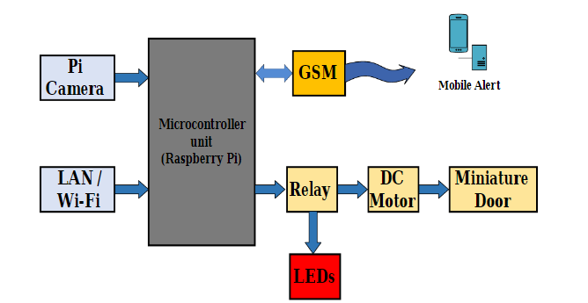
BLOCK DIAGRAM
Block Diagram of Door locking system.
*
Sinhgad College of Engineering, Pune – 41.
Department of Electronics &Telecommunication Engineering
9
Notes:
9
9

Slide 10
BLOCK DIAGRAM DESCRIPTION
The Microcontroller Unit During this diagram i.e., RASPBERRYPI is the brain of the whole design. Because it connects each part of the project with one another.
The person who arrives outside the door, his/her image is captured victimization the Pi Camera. Then that image is checked within the info that the owner has already created. This all is completed through the GSM module.
If the image matches with the pre-stored image with in the databases, then through raspberry pi the message is distributed to the relay module to open the door. And if the image doesn’t match them the message can move to the owner through the portal.
Then the owner can have full authority regarding what to try and do, whether to permit the person or not and consequently, save that person’s information within the prestored info.
*
Sinhgad College of Engineering, Pune – 41.
Department of Electronics &Telecommunication Engineering
10
Notes:
10
10

Slide 11
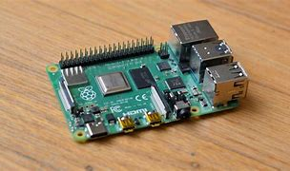
Specifications of Hardware
Raspberry pi 4 :
1. Processor: Broadcom BCM2711, quad-core Cortex-A72 (ARM v8) 64-bit SoC @ 1.5GHz
2. Memory: 1GB, 2GB or 4GB LPDDR4 (depending on model)
3. Connectivity: 2.4 GHz and 5.0 GHz IEEE 802.11b/g/n/ac wireless LAN,
Bluetooth 5.0,
4. GPIO: Standard 40-pin GPIO header
5. Video & sound: 2 × micro-HDMI ports,
2-lane MIPI DSI display port
2-lane MIPI CSI camera port
4-pole stereo audio and video port
6. SD card support: Micro SD card slot for loading operating system and data storage
7. Input power: 5V DC via USB-C connector, 5V DC via GPIO header
*
Sinhgad College of Engineering, Pune – 41.
Department of Electronics &Telecommunication Engineering
11
Notes:
11
11

Slide 12
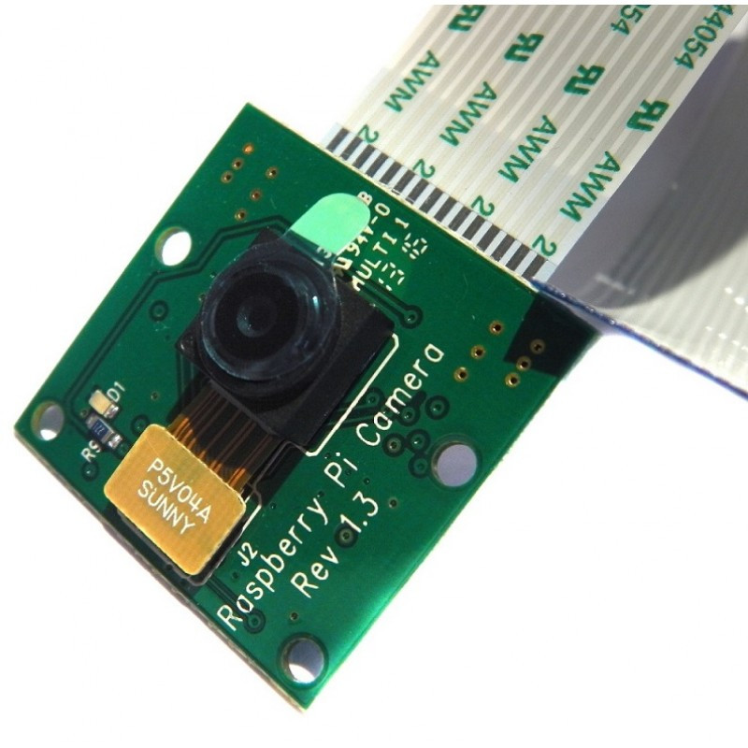
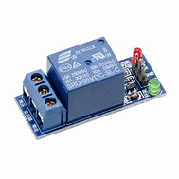
Specifications of Hardware
Raspberry Cam Module :
1. Operating Power: 60mW /15fps.
2. Sleeping Mode: < 20uA.
3. Lens Size: 1/6″.
4. Max. Frame Rate: 30fps VGA.
5. Sensitivity: 1.3V / (Lux-sec).
6. Dynamic range: 52dB.
7. Electronic Exposure: 1 to 510 row.
Single-Channel Relay Module :
1. Supply voltage: 3.75V to 6V
2. Quiescent current : 2mA
3. Current when the relay is active: ~70mA
4. Relay maximum contact voltage : 250Vac or 30Vdc
5. Relay maximum current : 10A
*
Sinhgad College of Engineering, Pune – 41.
Department of Electronics &Telecommunication Engineering
12
Notes:
12
12

Slide 13
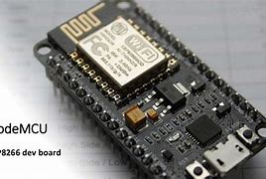
Specifications of Hardware
Node MCU :
1. Microcontroller: Tensilica 32-bit RISC CPU Xtensa LX106
2. Operating Voltage: 3.3V
3. Input Voltage: 7-12V
4. Digital I/O Pins (DIO): 16
5. Analog Input Pins (ADC): 1
6. Flash Memory: 4 MB
7. Clock Speed: 80 MHz
*
Sinhgad College of Engineering, Pune – 41.
Department of Electronics &Telecommunication Engineering
13
Notes:
13
13

Slide 14
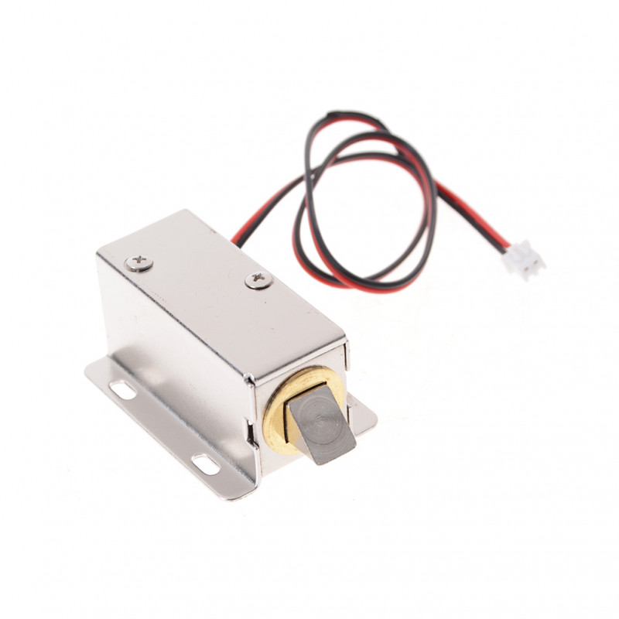
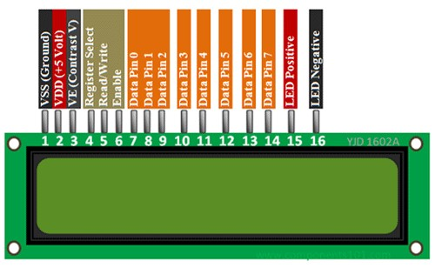
Specifications of Hardware
Solenoid Lock:
1. Iron Body Material
2. High quality ultra-compact electric lock.
3. Rustproof, durable, safe, convenient to use.
4. Suction tightly sucks the iron, thus locking the door.
5. Applicable for being installed in the escape door or fire door electronic controlled
system.
6. Adopts the principle of electric magnetism, when the current through the silicon, the
electromagnetic lock will achieve a strong
LCD Display :
*
Sinhgad College of Engineering, Pune – 41.
Department of Electronics &Telecommunication Engineering
14
Notes:
14
14

Slide 15
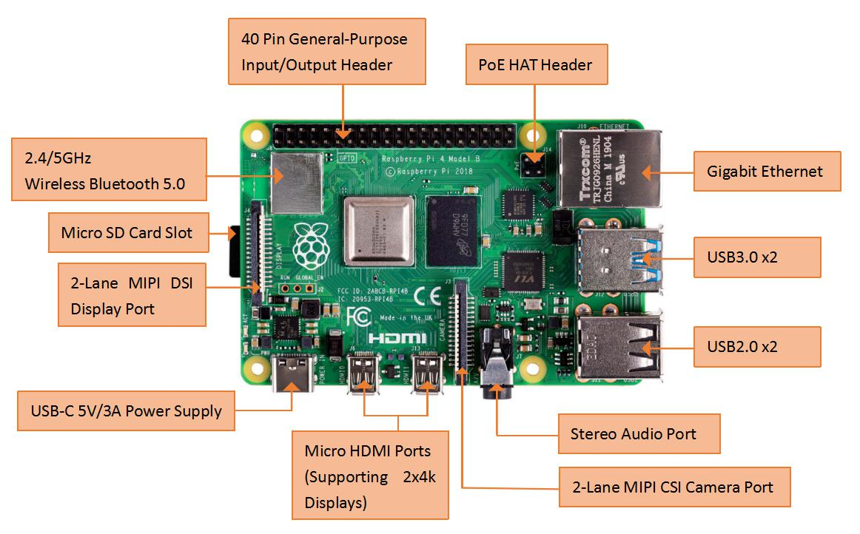
Why Raspberry Pi …?
Stronger and quicker processor. Also multitasking is available.
Built-in Ethernet port, Wi-Fi and Bluetooth capability.
Audio output, Camera port, USB port, HDMI output all are included in Raspberry Pi.
Hence making less use of other ports and hence cost saving.
Great for projects that need to connect online and have multiple activities going on at the same time.
*
Sinhgad College of Engineering, Pune – 41.
Department of Electronics &Telecommunication Engineering
15
Notes:
15
15

Slide 16
Software Application Used
1. OpenCV (Open-Source Computer Vision):
OpenCV is an open platform for programmers for real time computer vision and computations. It supports many libraries of programming functions. It is built on C++ and has bindings with Java, Python & MATLAB. It runs on a huge variety of platforms like Windows, Linux, Android, iOS, macOS, and many more. Image and Video processing are two of the main applications of OpenCV.
2. Python Software Development Kit:
Python is a high-level general purpose programming language. Its design philosophy emphasizes code readability with the use of significant indentation.
3. Operating System: Windows
4. Language Used: Python (In Raspberry Pi), Embedded C (In Node MCU)
*
Sinhgad College of Engineering, Pune – 41.
Department of Electronics &Telecommunication Engineering
16
Notes:
16
16

Slide 17
SIMULATION
Relay is ON as the face does matches and the LCD display anything access granted.
*
Sinhgad College of Engineering, Pune – 41.
Department of Electronics &Telecommunication Engineering
17
Notes:
17
17

Slide 18
SIMULATION
Relay is OFF as the face does not matches and the LCD does not display anything.
*
Sinhgad College of Engineering, Pune – 41.
Department of Electronics &Telecommunication Engineering
18
Notes:
18
18

Slide 19
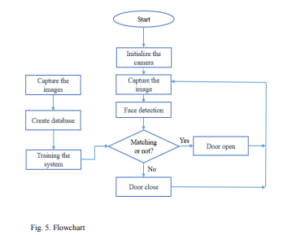
Flowchart
*
Sinhgad College of Engineering, Pune – 41.
Department of Electronics &Telecommunication Engineering
19
Notes:
19
19

Slide 20
IMPLEMENTATION
Steps carried out to perform face recognition :
1. The database is created which will contain the images of the persons to be recognized.
2. The features are extracted, and the system is trained using it.
3. When an image is input to the system, first it checks whether the image contains any
face with the help of a face detection algorithm.
4. The features of the face are extracted and given to the recognizer/ classifier.
5. The recognizer based on the input from the trainer and the features of the input
image will recognize the face.
*
Sinhgad College of Engineering, Pune – 41.
Department of Electronics &Telecommunication Engineering
20
Notes:
20
20

Slide 21
ALGORITHM
Local Binary Pattern Histogram(LBPH) –
The LBPH algorithms – signs the pixel so fan image with binary values by comparing each pixel with the neighborhood. Suppose that we are interested in calculating the LBPH value for the pixel. The Local Binary Pattern Histogram (LBPH) algorithm is illumination invariant. If the lighting condition of the scene is changed, all the pixel values will vary but the relative difference between the pixels will remain the same making the algorithm illumination invariant.
*
Sinhgad College of Engineering, Pune – 41.
Department of Electronics &Telecommunication Engineering
21
Notes:
21
21

Slide 22
ALGORITHM
*
Sinhgad College of Engineering, Pune – 41.
Department of Electronics &Telecommunication Engineering
22
Notes:
22
22

Slide 23
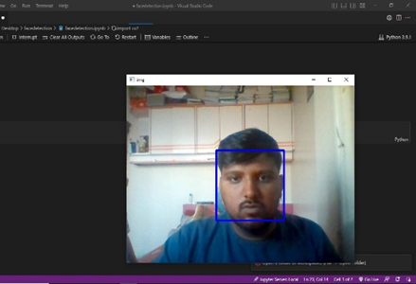
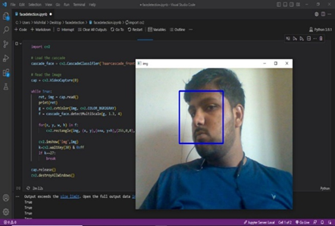
RESULT
The result of our project is that recognition of stored images in the data base after recognizing the face the door lock will get open.
*
Sinhgad College of Engineering, Pune – 41.
Department of Electronics &Telecommunication Engineering
23
Notes:
23
23

Slide 24
RESULT
Hardware setup of the system.
*
Sinhgad College of Engineering, Pune – 41.
Department of Electronics &Telecommunication Engineering
24
Notes:
24
24

Slide 25
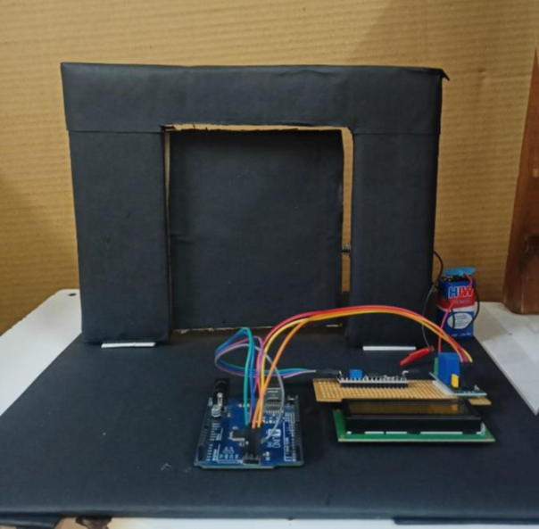
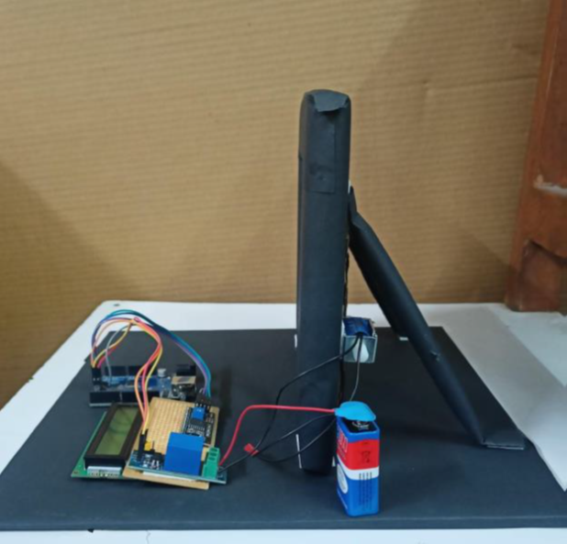
HARDWARE PROTOTYPE
Prototype of the project
Profile side of the project
*
Sinhgad College of Engineering, Pune – 41.
Department of Electronics &Telecommunication Engineering
25
Notes:
25
25

Slide 26
APPLICATIONS
House & Bungalows
Offices
Apartments
Farmhouses
Security Purpose
Any of the restricted areas
*
Sinhgad College of Engineering, Pune – 41.
Department of Electronics &Telecommunication Engineering
26
Notes:
26
26

Slide 27
ADVANTAGES
Automatic Visitor Recognition
Voice Assisted Interface
Instant Online Alerts on Desktop/Mobile
Ability to Sound Alarm at remote Location
Monitor Activity Outside the House at any Time
Fully Automated System
*
Sinhgad College of Engineering, Pune – 41.
Department of Electronics &Telecommunication Engineering
27
Notes:
27
27

Slide 28
CONCLUSIONS
The proposed system allows remote access to lock or unlock the door without physical user interaction.
The system fulfils the requirements of supporting autonomous locking device and easy key distribution compared to physical keys.
The intrusion alert enhances the security of the system.
*
Sinhgad College of Engineering, Pune – 41.
Department of Electronics &Telecommunication Engineering
28
Notes:
28
28

Slide 29
FUTURE SCOPE
The above-proposed system can have many applications due to its practicality and its security aspect. Some of them are:
Can be used for doors at Home and Offices
Can be used for Industrial doors
Can be used for high-security Bank vault doors
And practically any place where remote controlling is required.
For future scope, the device can be paired with a CCTV module to enhance security. Additional biometrics, and iris recognition can be installed.
*
Sinhgad College of Engineering, Pune – 41.
Department of Electronics &Telecommunication Engineering
29
Notes:
29
29

Slide 30
REFERENCES
1. M.B.H, J.S, K.D.M, L.C. Govinda pillai and J.C.J.R, "Face Recognition Door Lock System Using
Raspberry Pi," 2022 8th International Conference on Advanced Computing and Communication Systems
(ICACCS), 2022, pp. 1645-1648, DOI: 10.1109/ICACCS54159.2022.9785217.
2. S. Shetty, S. Shetty, V. Vishwakarma and S. Patil, "Review Paper on Door Lock Security Systems", 2020
International Conference on Convergence to Digital World - Quo Vadis (ICCDW), pp. 1-4, 2020.
3. Face Recognition Door Lock - Ling Zeng (LZ455), Rong Sun(RS2364)
4. Windows IoT Facial Recognition Door (Microsoft) - Jonathan Chiu, Sara, Yen Lee
5. V. Pandit, P. Majgaonkar, P. Meher, S. Sapaliga and S. Bojewar, "Intelligent security lock," 2017
International Conference on Trends in Electronics and Informatics (ICEI), 2017, pp. 713-716, doi:
10.1109/ICOEI.2017.8300795.
6. A. Nag, J. N. Nikhilendra and M. Kalmath, "IOT Based Door Access Control Using Face Recognition,"
2018 3rd International Conference for Convergence in Technology (I2CT), 2018, pp. 1-3, doi:
10.1109/I2CT.2018.8529749
7. A. . Purushothaman and S. Palaniswamy, "Pose and Illumination Invariant Face Recognition for
Automation of Door Lock System," 2018 Second International Conference on Inventive Communication
and Computational Technologies (ICICCT), 2018, pp. 1105-1108, doi: 10.1109/ICICCT.2018.8473103
*
Sinhgad College of Engineering, Pune – 41.
Department of Electronics &Telecommunication Engineering
30
Notes:
30
30

Slide 31
Thank You !!
*
Sinhgad College of Engineering, Pune – 41.
Department of Electronics &Telecommunication Engineering
31
Notes:
31
31

